Slide 1


Entrepreneurship and business modelling
Final Evaluation
Retail Experience
Adrián Barba Beltrán
Rodrigo Martín Gómez del Moral Herranz
Álvaro Honrubia Genilloud
César Pantoja Rosales
Javier Rodríguez García
Jose Antonio Ruiz Heredia

Slide 2

Logo & Slogan
REX
Sell More Operate Smarter Grow Faster

Slide 3
Executive Summary
What is Rex?
Why is it necessary?
A platform for modern POS systems that helps businesses sell more, operate smarter, and grow faster.
Traditional POS systems are slow, outdated, and make real-time decision-making difficult.
What solution does REX offer?
A connected, fast, and scalable system built on modern technology.

Slide 4
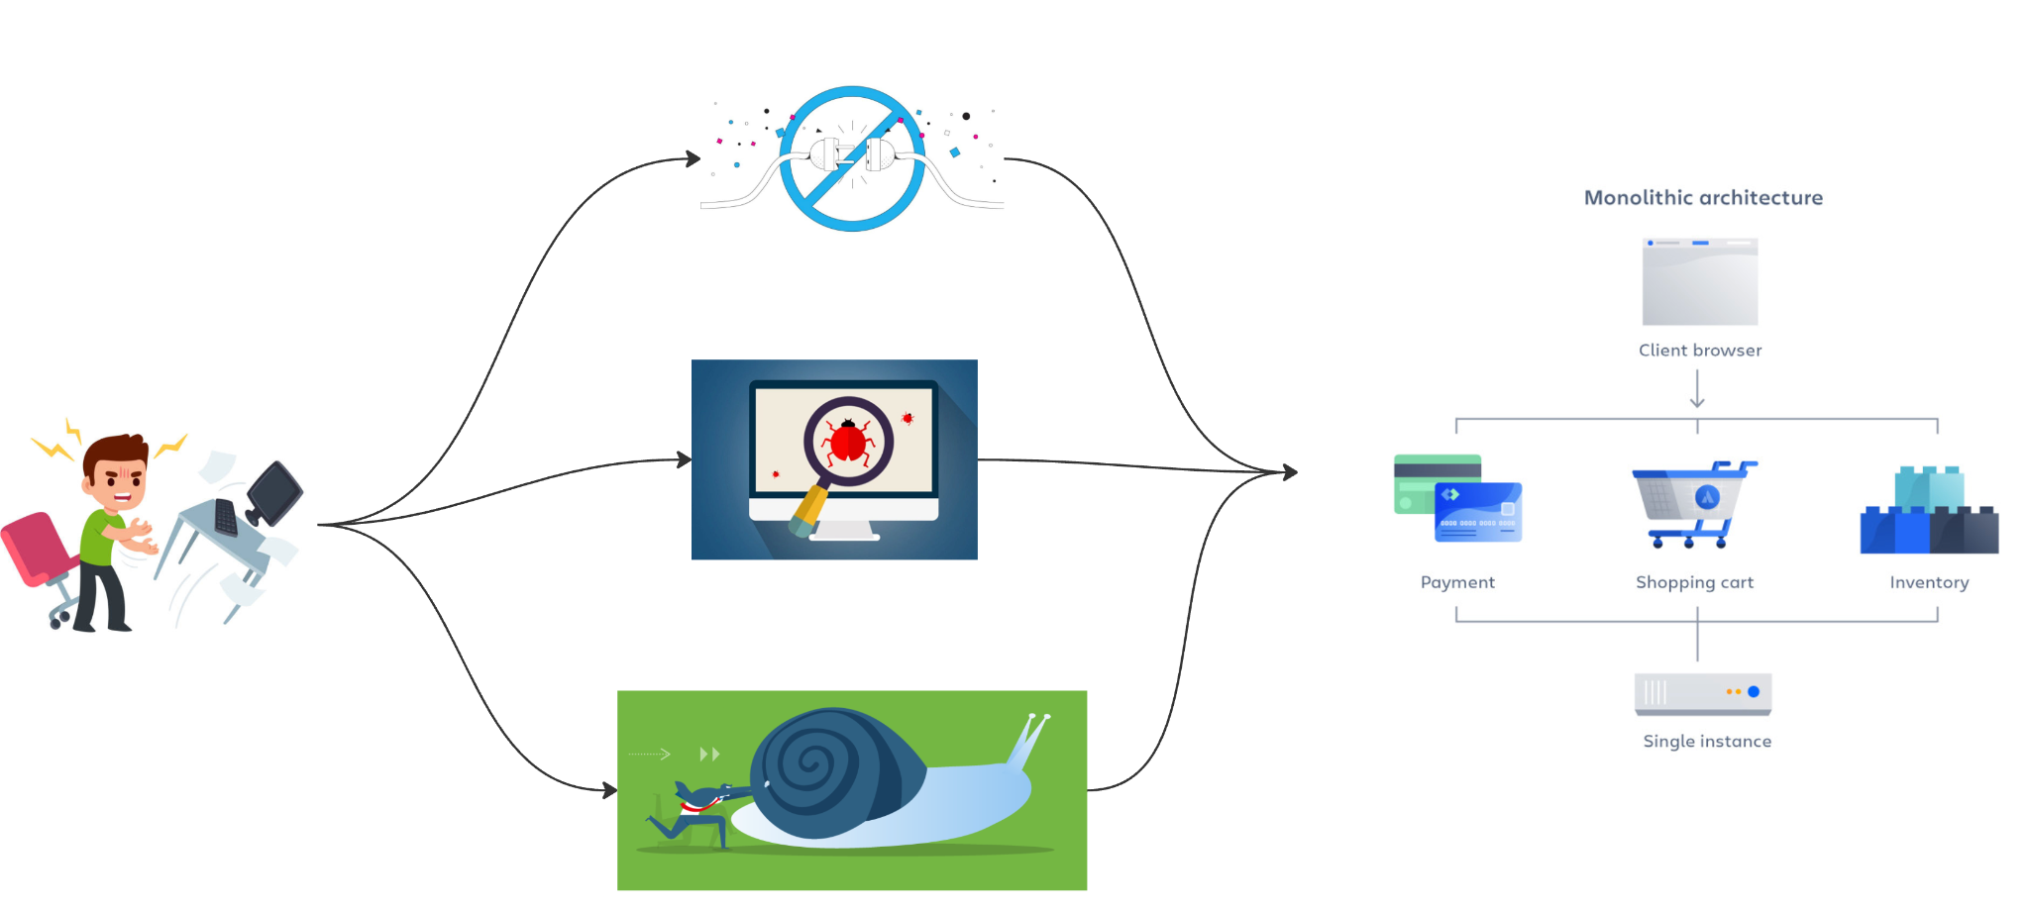
Problem
Current problems in traditional retail
Impact
Disconnected systems: Separate inventory, payments and customers.
Lack of accessibility: Software tied to a single device, impossible to manage remotely.
High costs: Requires expensive servers, constant updates and specialised technical support.
Time wasted manually managing inventories.
Customers lost due to slow and obsolete systems.
High operating costs limit growth.

Slide 5





Solution
Tax Automation and Regulatory Compliance
Superior User Experience
Exclusive Integrations
REX ensures tax compliance and data security with automated invoicing and advanced cybersecurity.
REX offers an intuitive, customizable interface with proactive support and personalized technical assistance.
REX connects seamlessly with e-commerce, CRMs, and ERP systems, enabling real-time synchronization with marketplaces and payment gateways.
Accessibility and Flexibility
Process Optimization
Its cloud-based platform allows access from any device and supports both mobile devices and physical POS systems.
REX automates inventory management, provides real-time reporting, and offers sales analytics to enhance decision-making.

Slide 6
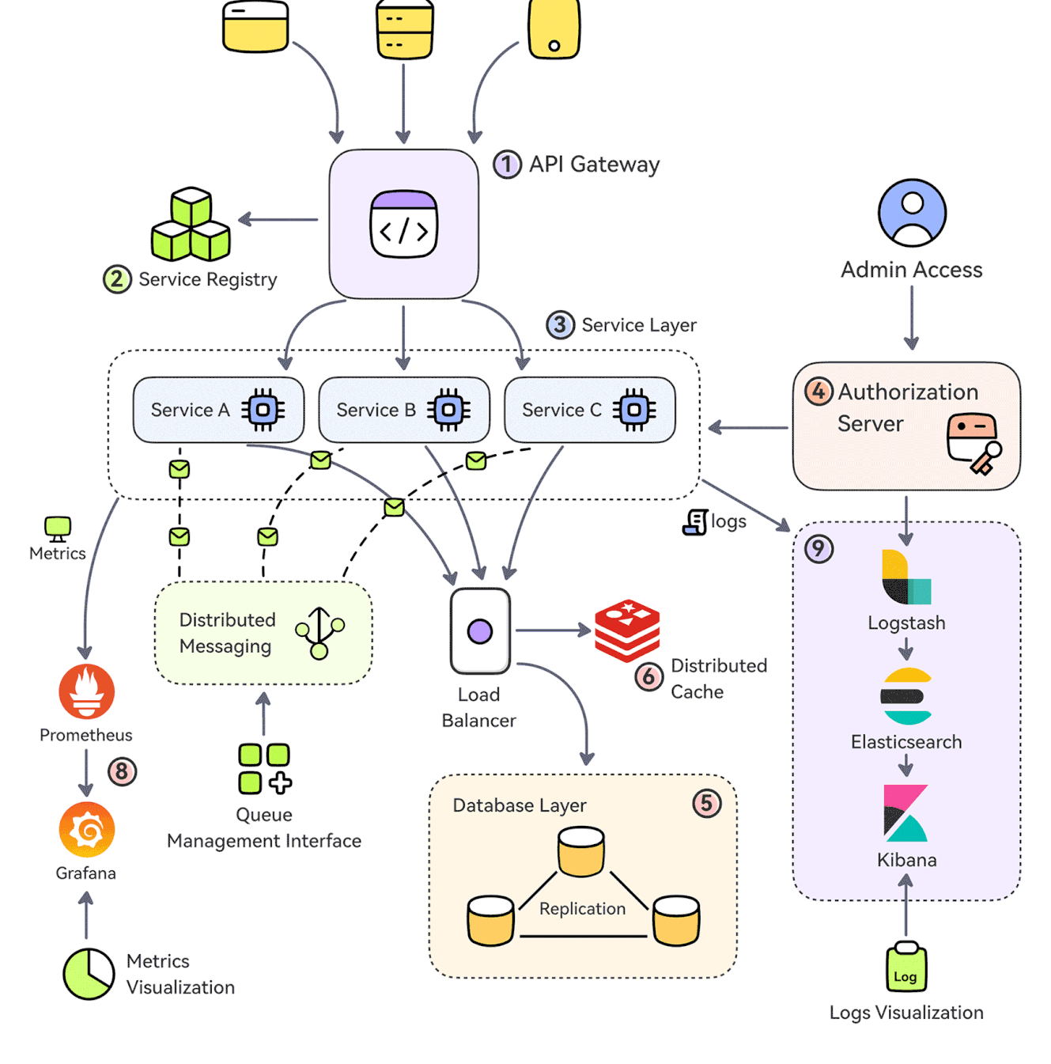
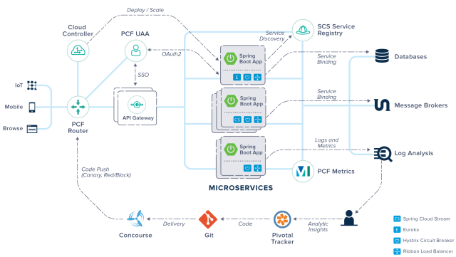
Solution - Architecture

Slide 7
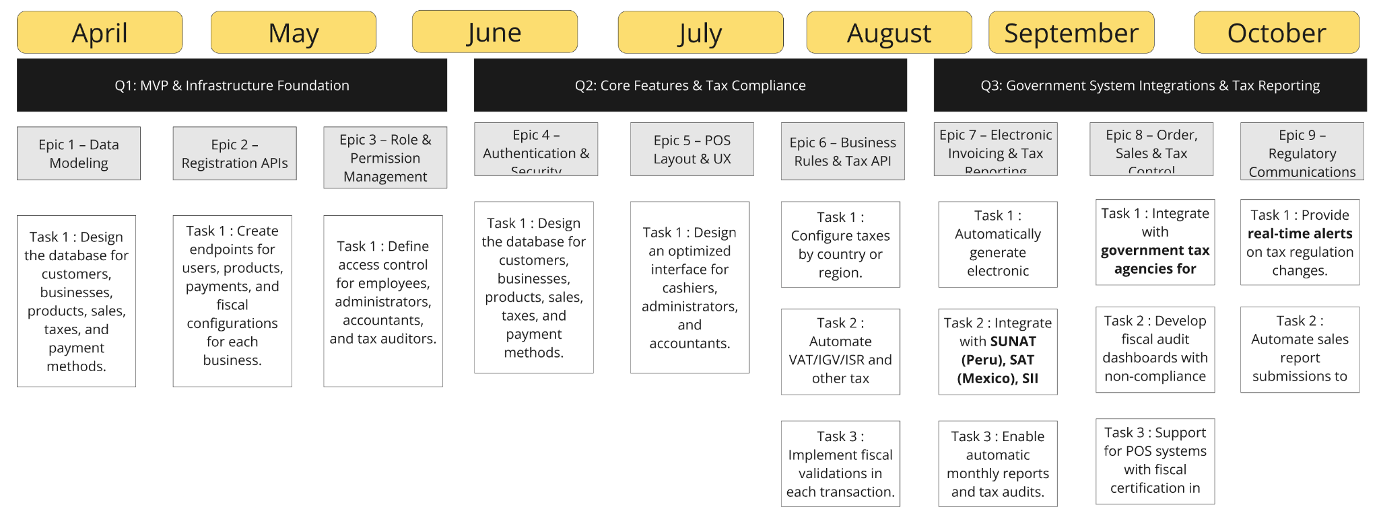
Solution - ROADMAP REX – RETAIL & TPVs

Slide 8



Market Size
SOM
1
$500M initial target
SAM
2
$6B LATAM & Europe
TAM
3
$25B global POS market
Expansion potential
Rapid scalability in markets with low digitalisation
Growth potential in hybrid commerce regions

Slide 9
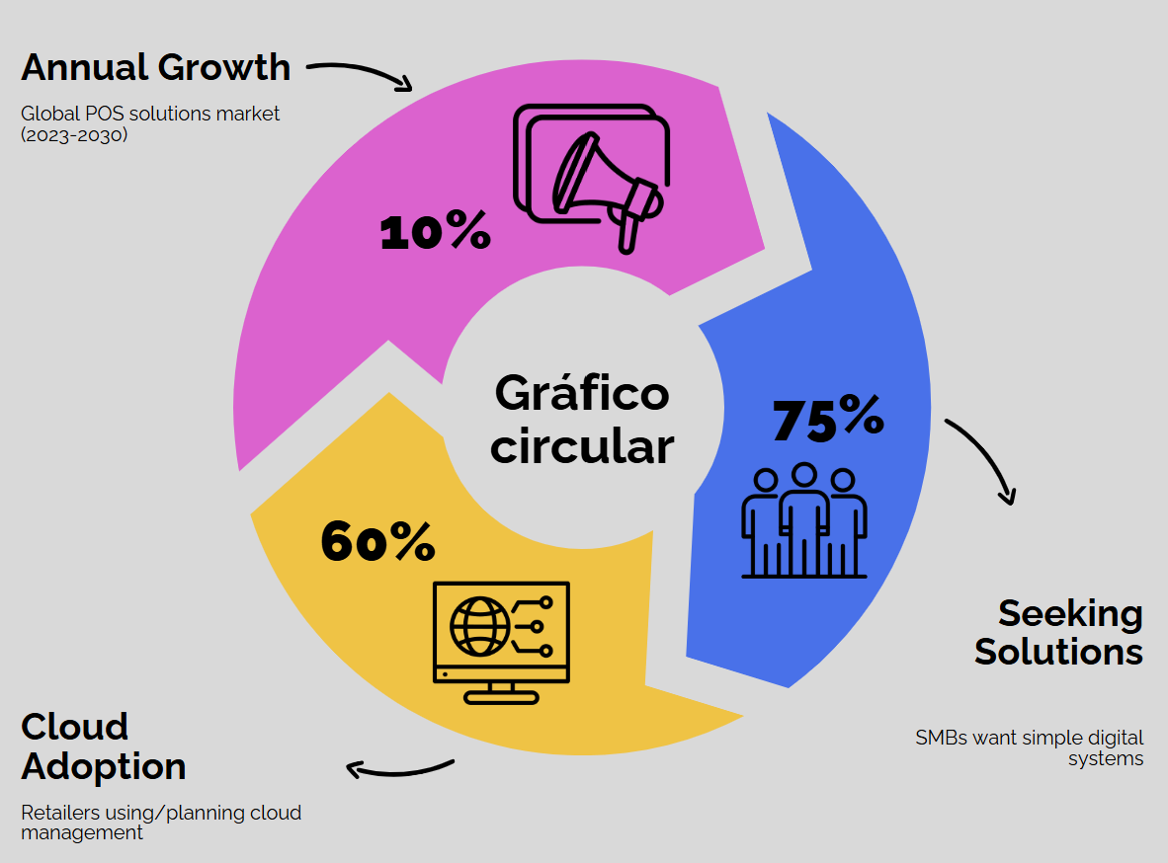
Market Validation

Slide 10
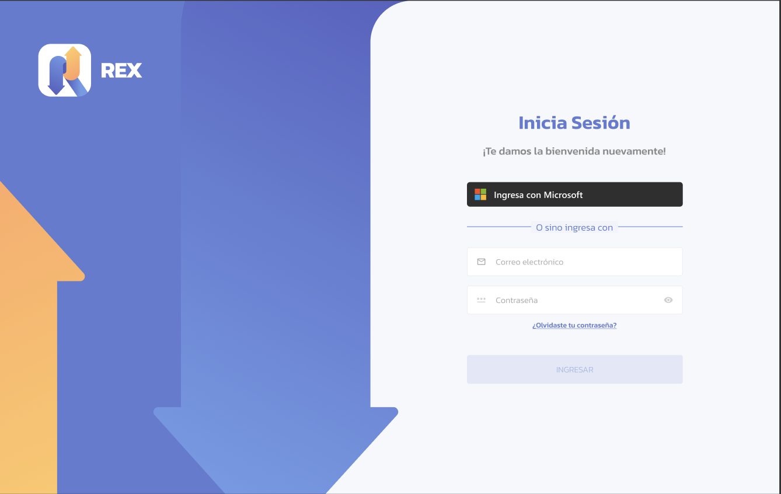
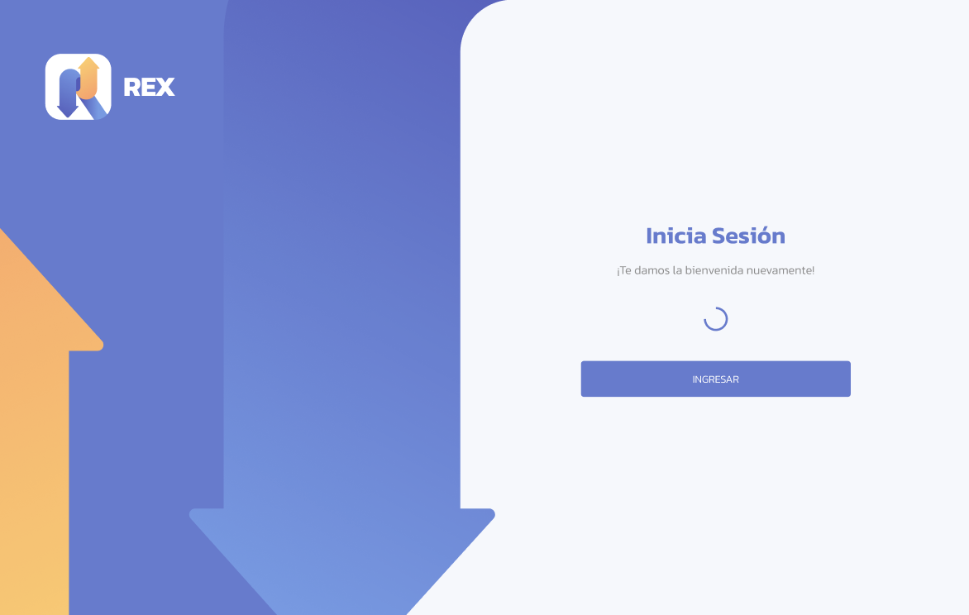
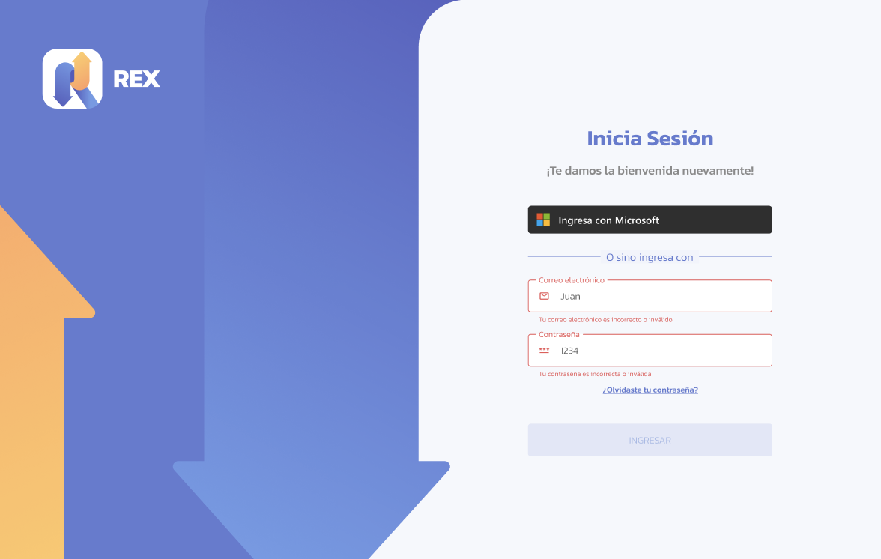
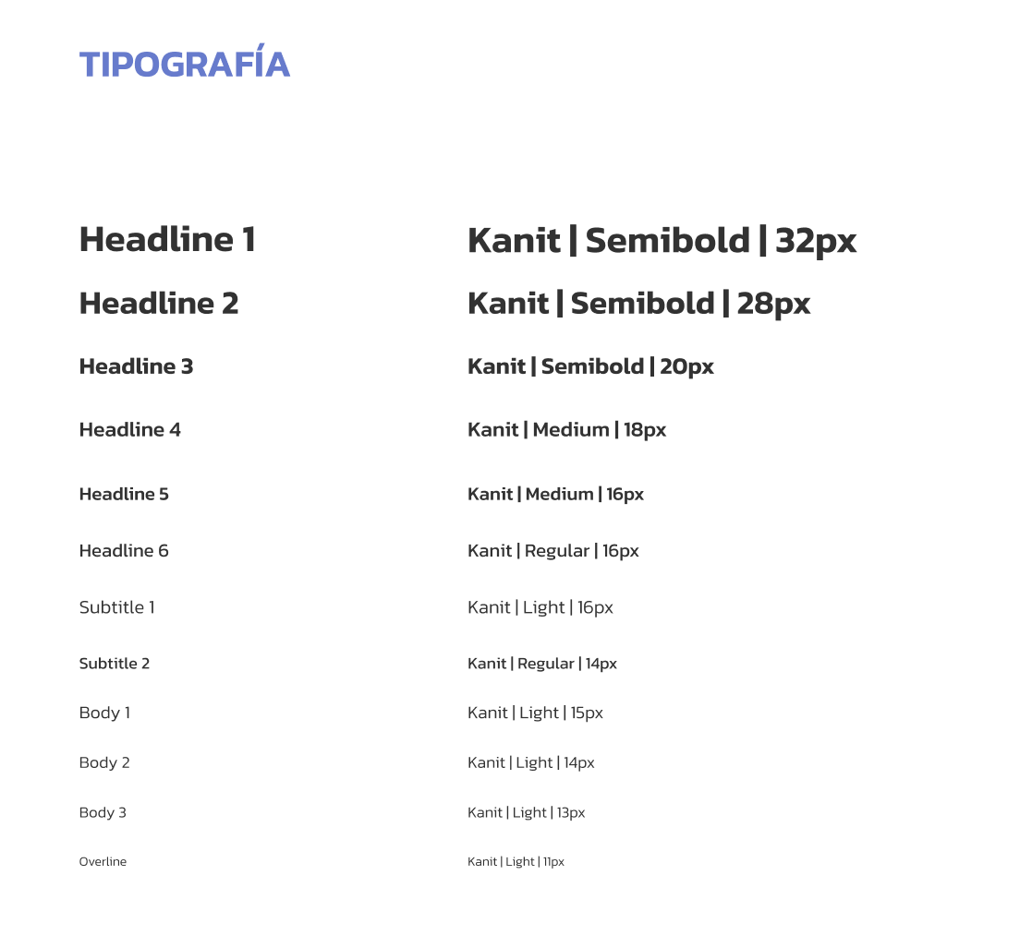
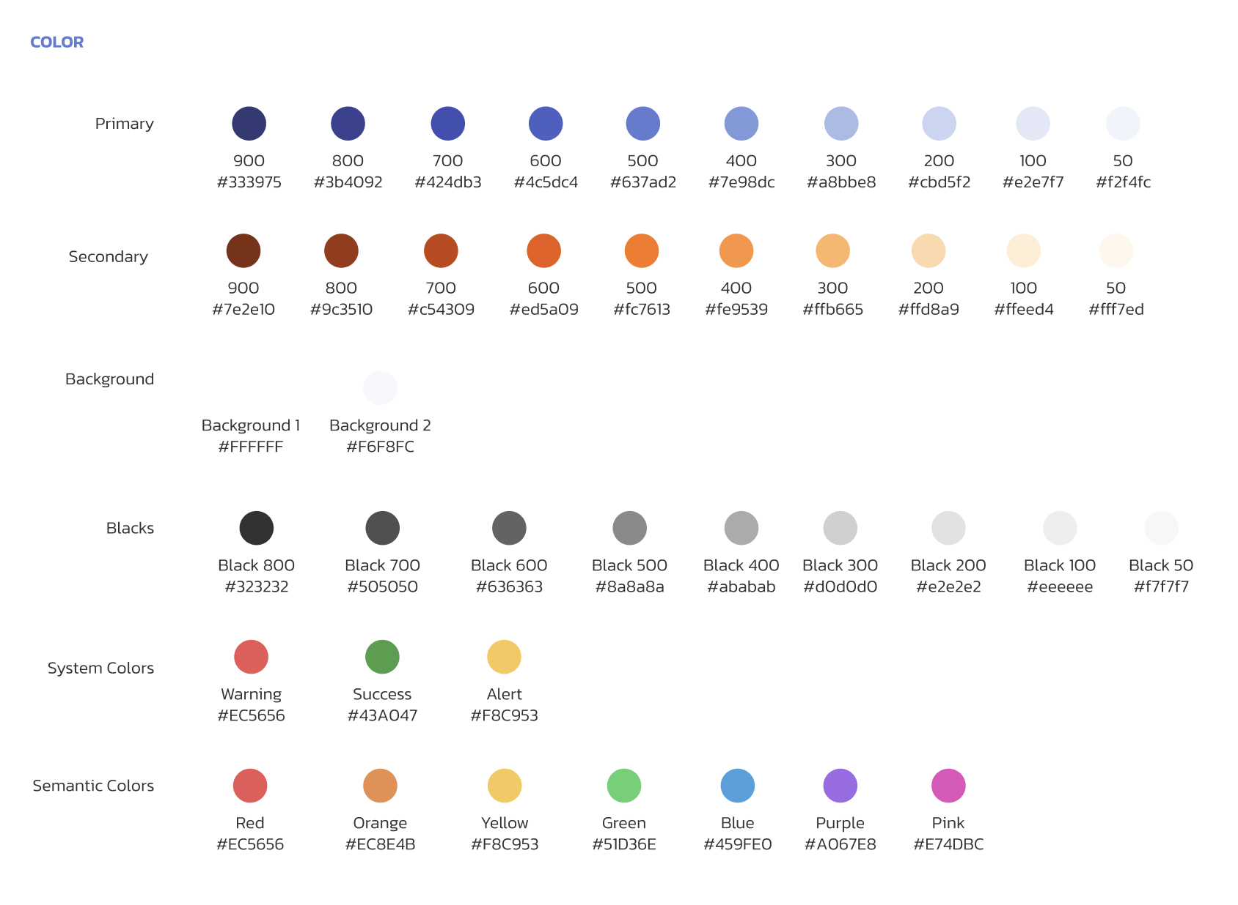
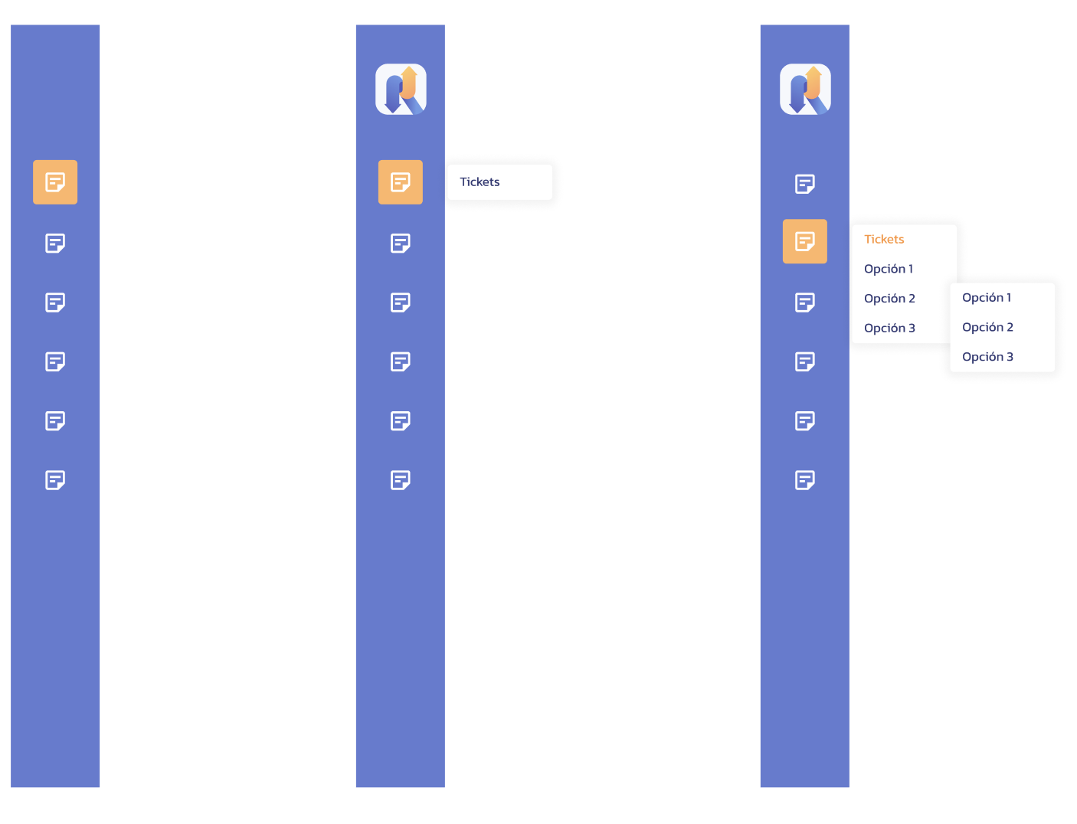
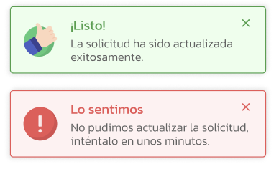
Product/Mockup

Slide 11
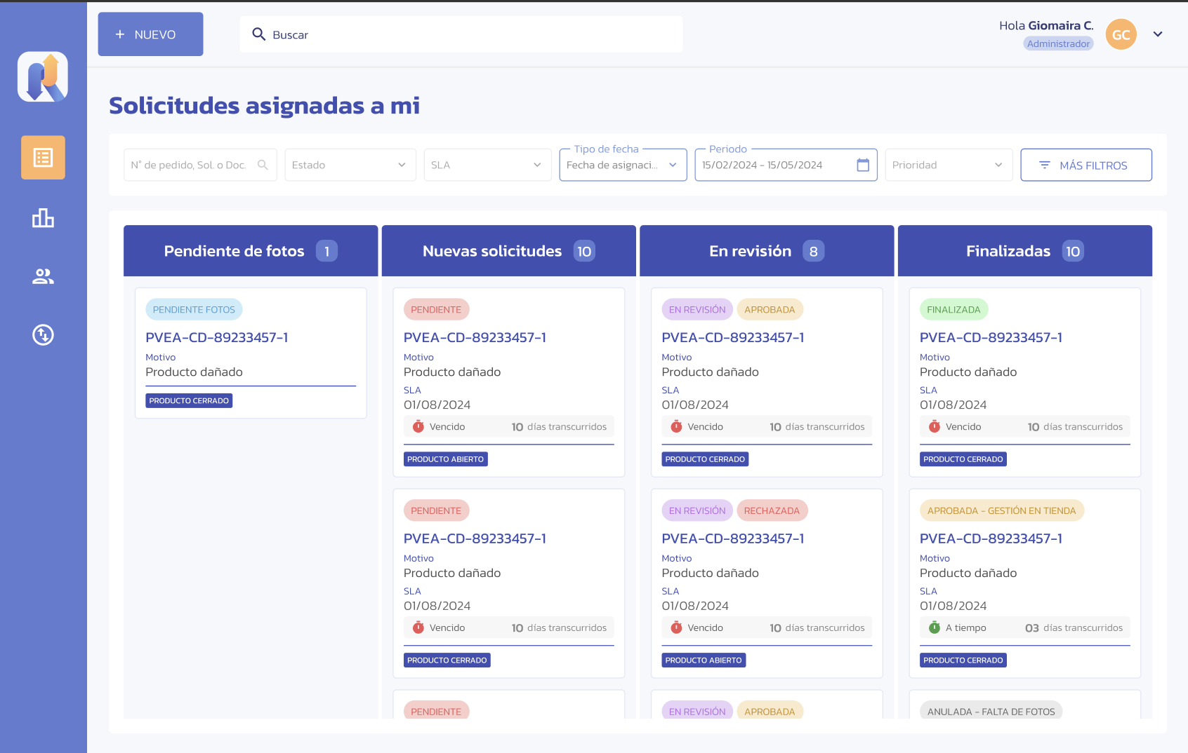
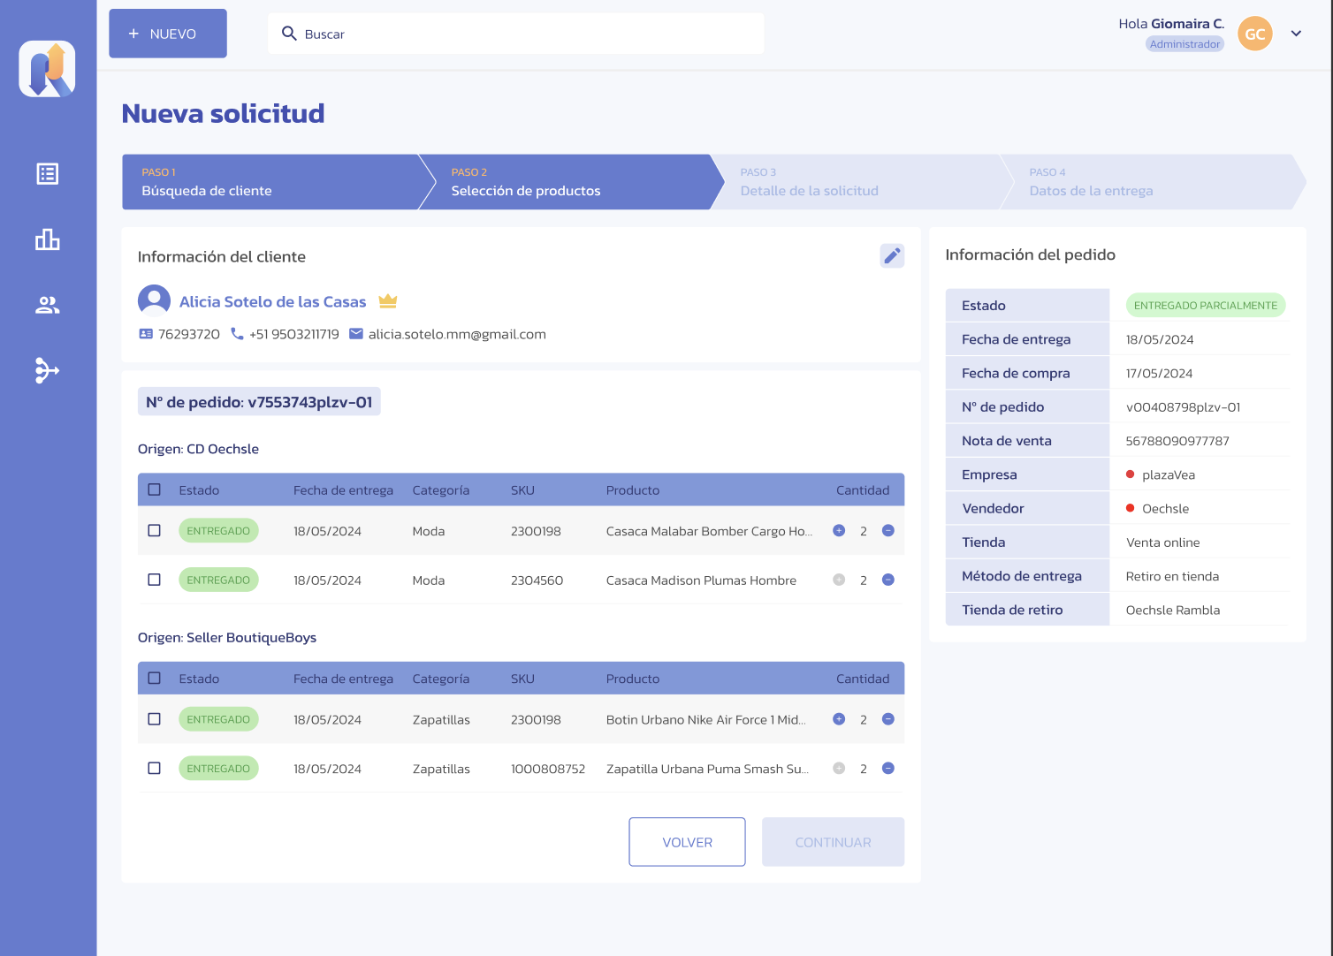
Product/Mockup

Slide 12
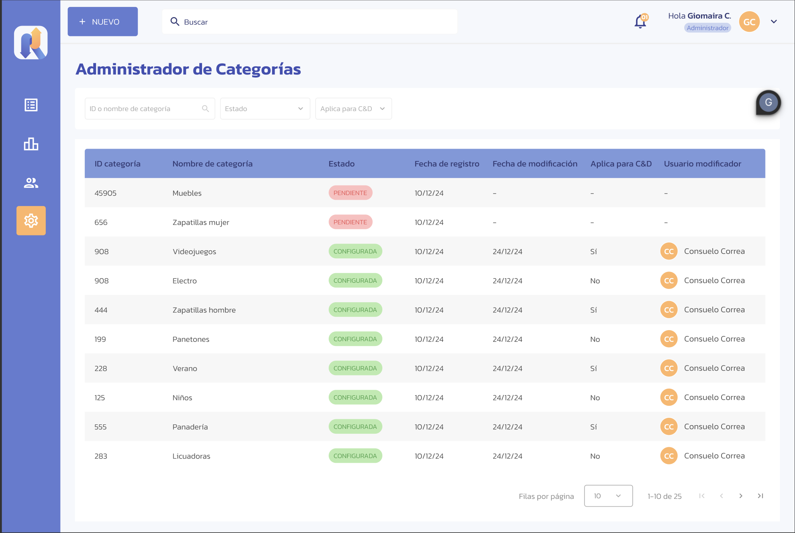
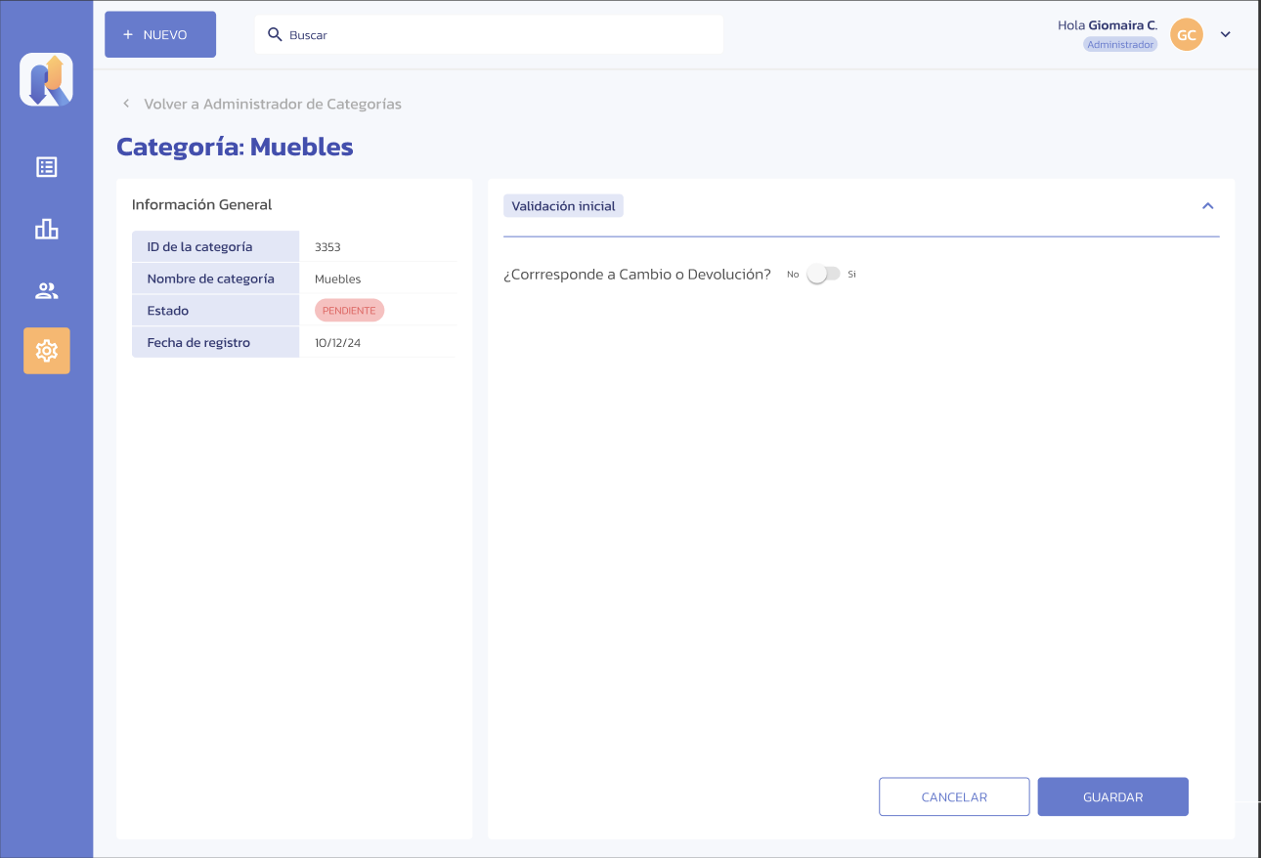
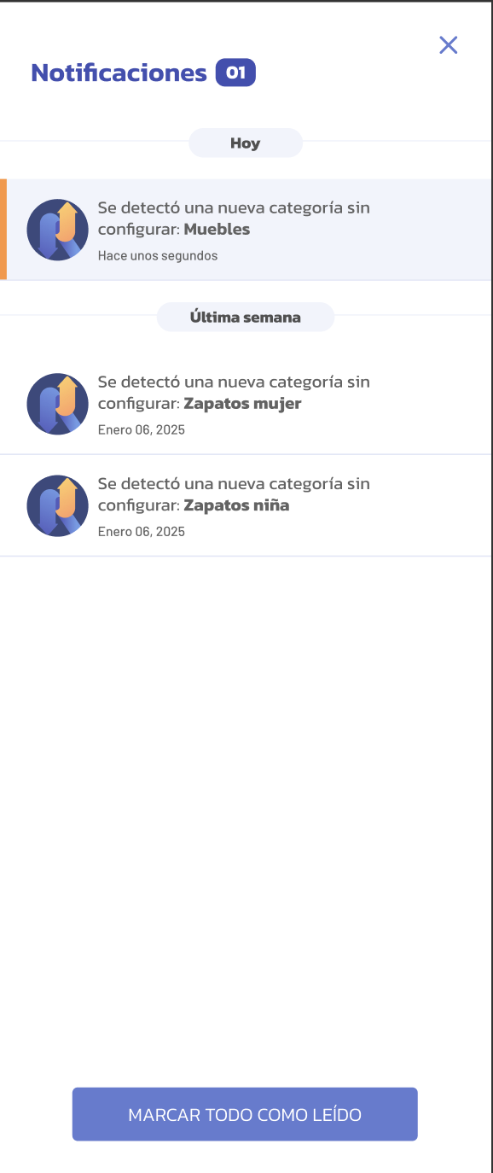
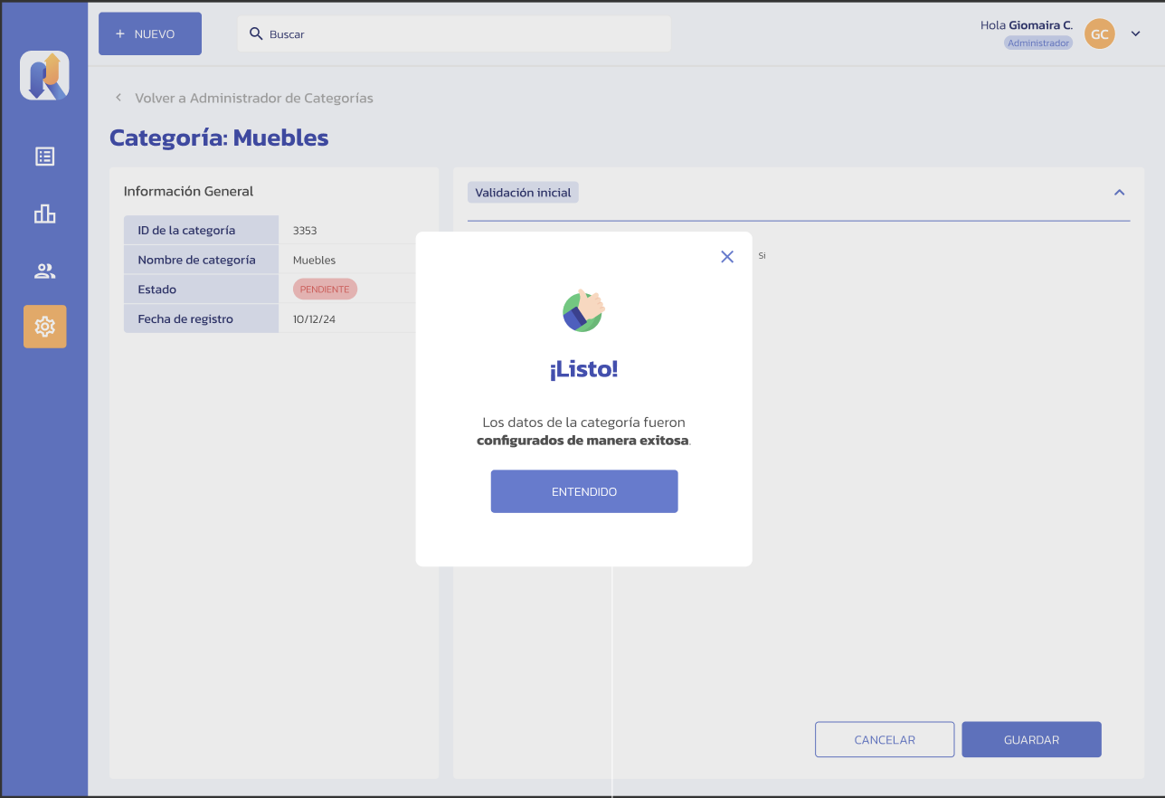
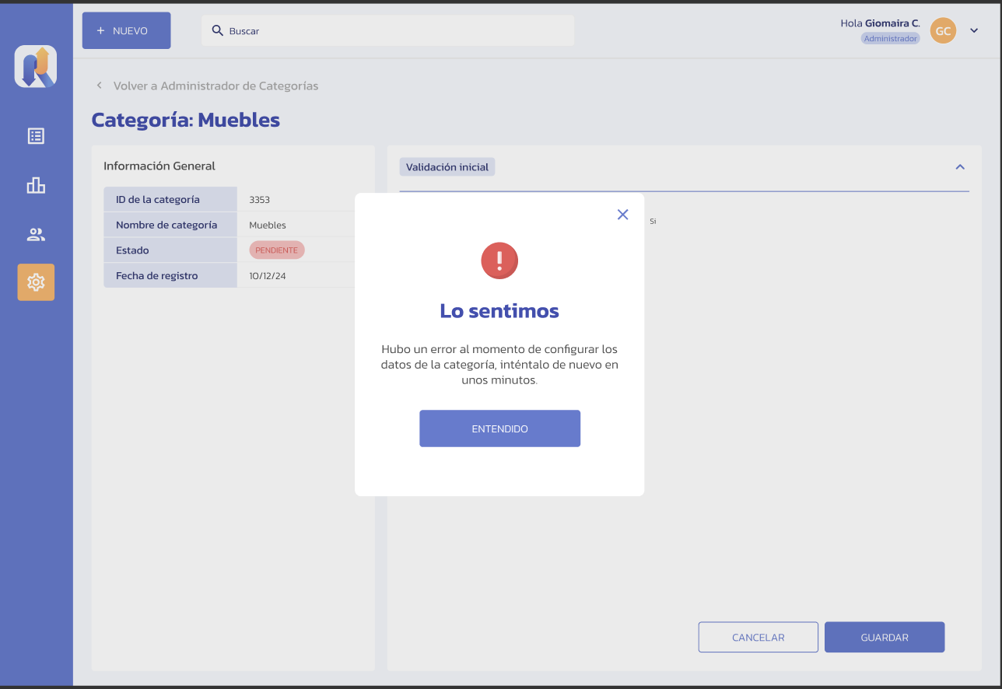
Product/Mockup

Slide 13
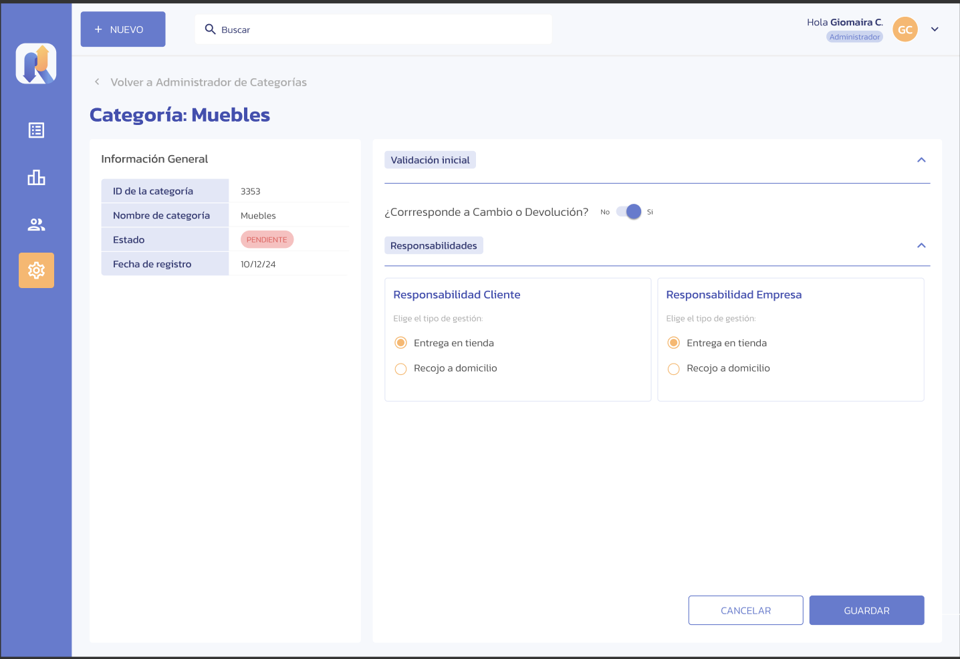
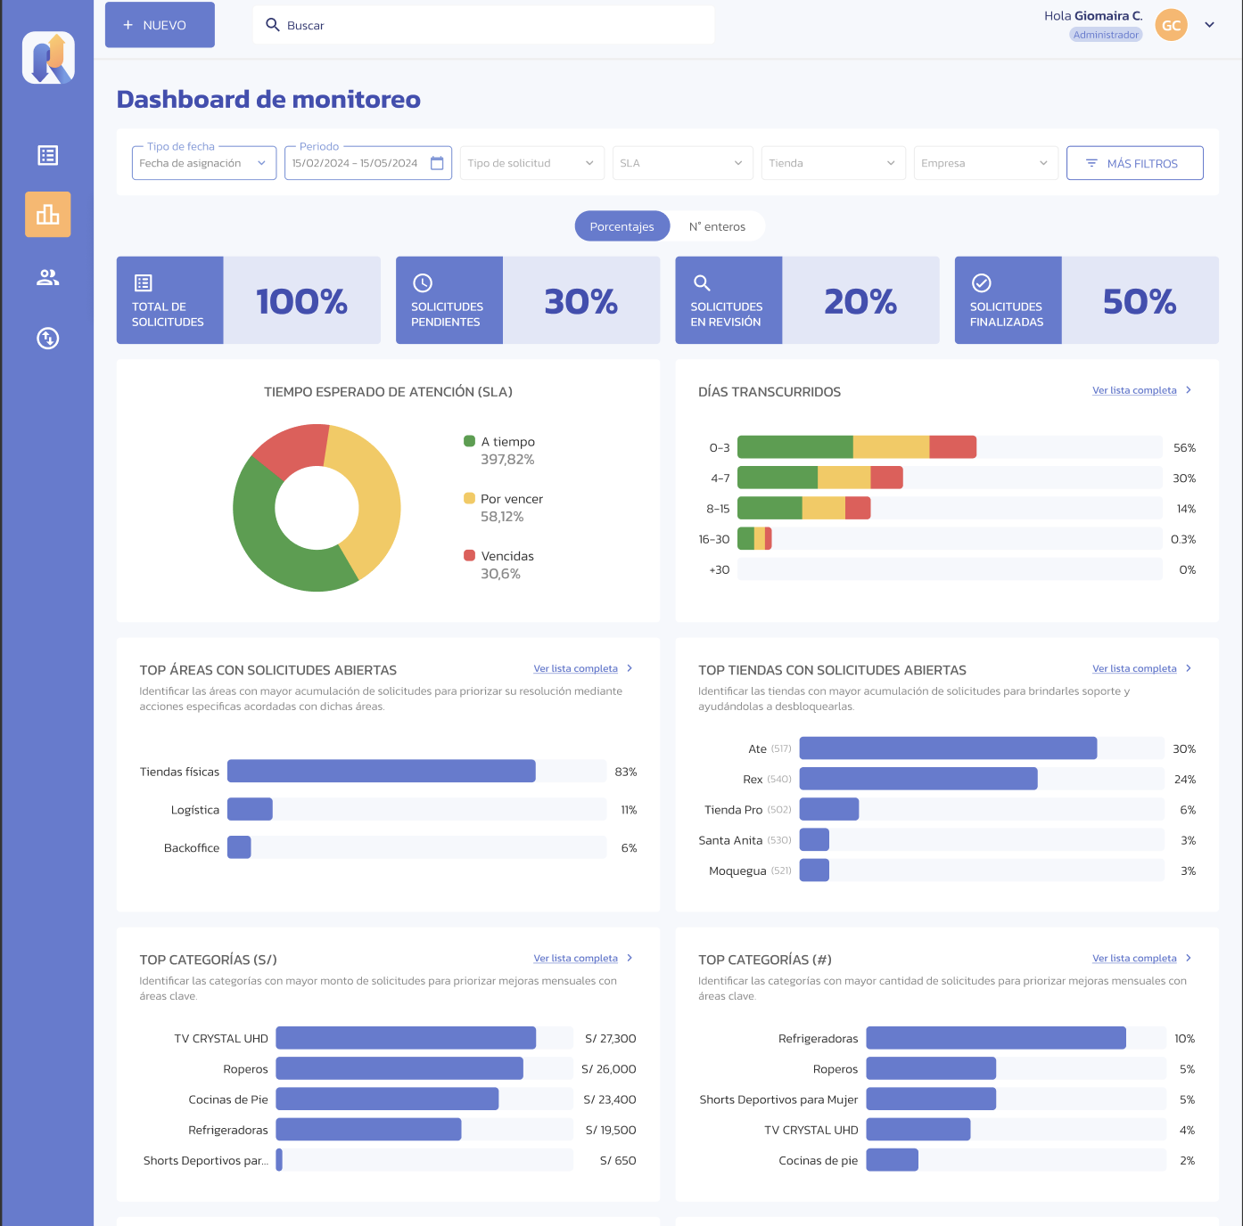
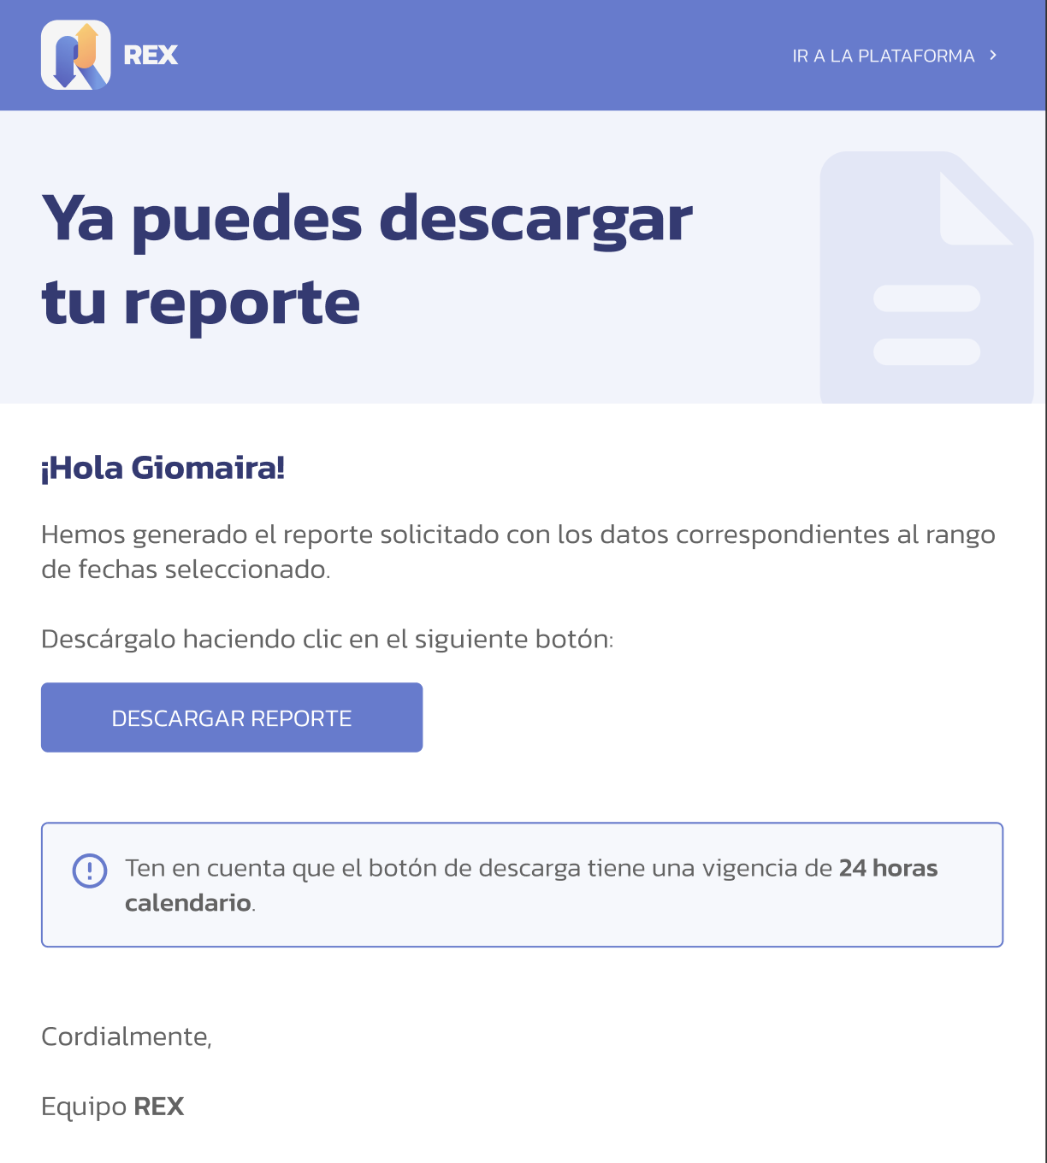
Product/Mockup

Slide 14
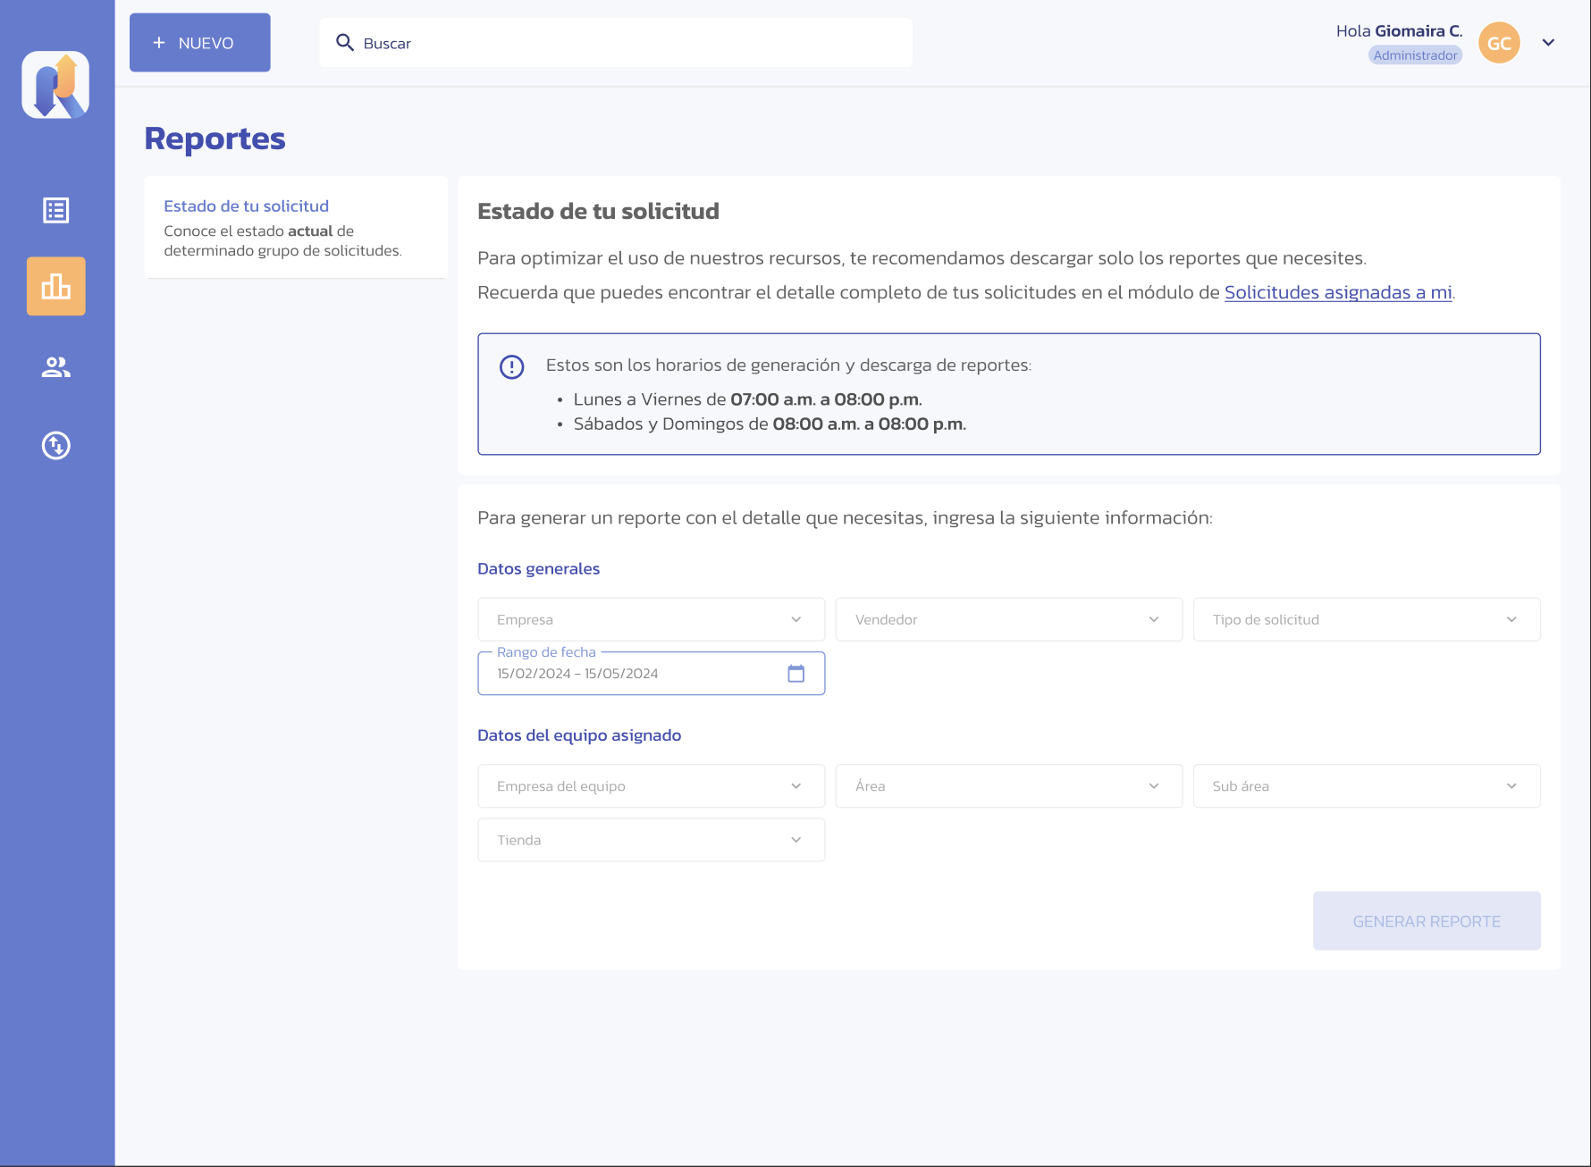
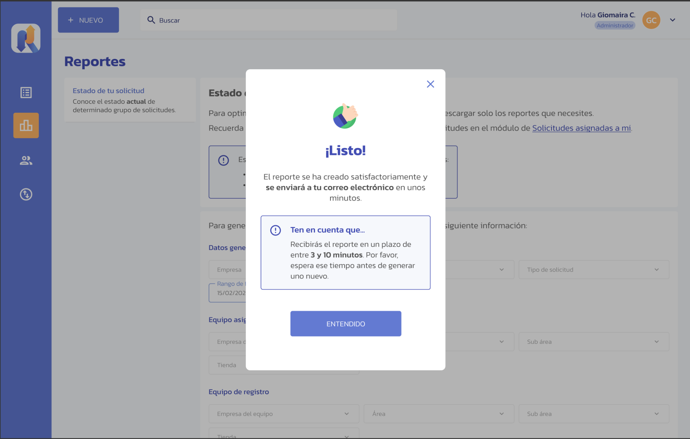
Product/Mockup

Slide 15
Business Model
SaaS Model – Scalable Subscription
Hardware Sales & Installation
Integration Commissions
Monthly POS subscription plans with a multi-tenant architecture, tailored to fiscal regulations and global business needs, with user subscription options for access to premium features like advanced reports and personalized dashboards.
Revenue from the sale, installation, and maintenance of POS systems, printers, and scanners for physical stores.
Monetization through integrations with e-commerce platforms, ERPs, CRMs, and payment gateways.
Minute Bank
Consulting & Support
Prepaid service packages for software customization, process automation, and tailored integrations.
Digitalization, optimization, and technical support services with on-demand or subscription-based payment options.

Slide 16
Adoption Strategy
How We Will Get Businesses to Use REX ?
Strategic Partnerships
Integration with Digital Ecosystems
REX expands through partnerships with hardware companies for POS systems, printers, and scanners, financial institutions to facilitate SME financing, and software developers for custom integrations, ensuring fast market access.
REX connects with e-commerce platforms (Shopify, WooCommerce, Magento, Amazon), CRMs, ERPs, productivity tools (Slack, Teams, Zapier, HubSpot), and payment gateways, allowing businesses to integrate it seamlessly into their existing infrastructure.
Distribution and Growth Channels
Acquisition and Growth Strategy
REX adoption is driven through direct sales on its web platform, presence in marketplaces and payment platforms, partnerships with banks for financing, and mobile and web applications for easy accessibility.
REX accelerates adoption through technology and retail events, loyalty programs, educational digital marketing, and a referral strategy with incentives for customers who recommend the platform.

Slide 17
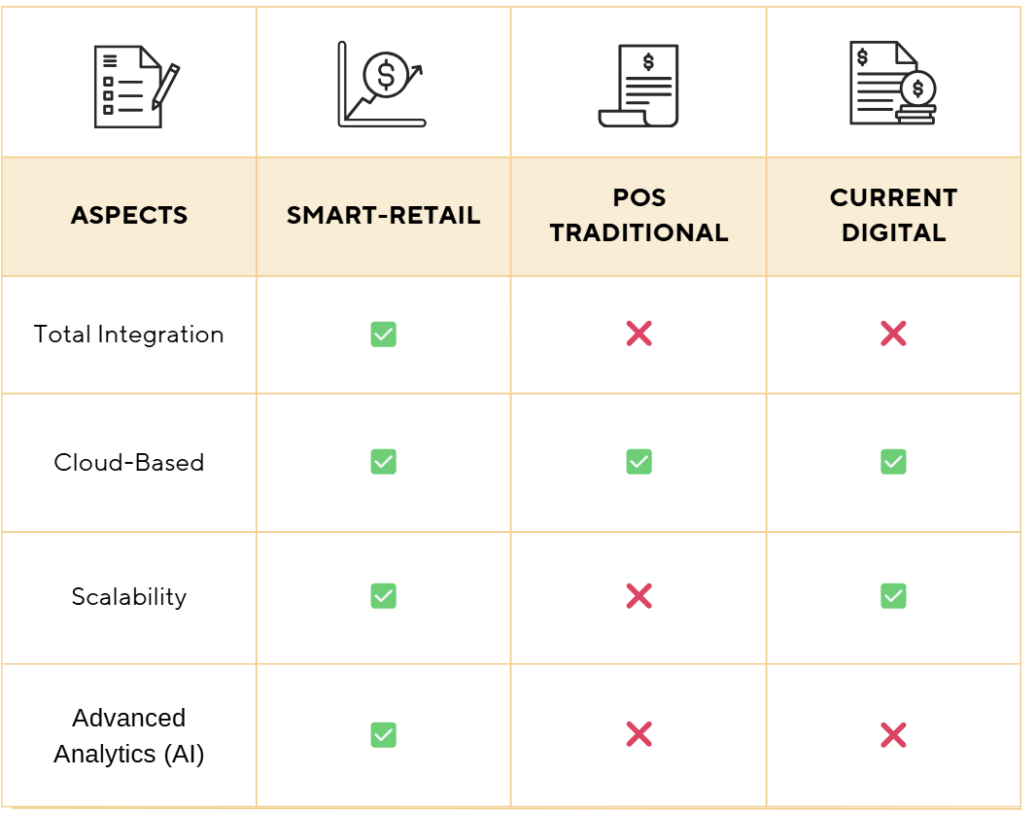
Competition
Clear competitive advantage
A unique combination of total integration, scalability, cloud accessibility, and intelligent analytics powered by AI

Slide 18






Team
🔸 José Antonio Ruiz Heredia – Project Owner/ UX - UI (+8 years managing technology projects)
🔸 Rodrigo Martín Gómez del Moral Herranz – Project Manager/ scrum master (Experienced in LATAM startup expansion)
🔸 Adrián Barba Beltrán– Data Analyst (Specialist in predictive modeling and consumer analysis)
🔸 César Pantoja Rosales – Full-Stack Developer/architecture (Experienced in cloud-based platforms development)
🔸 Álvaro Honrubia Genilloud– DevOps Engineer (Expert in infrastructure automation, CI/CD pipelines, and cloud architecture)
🔸 Javier Rodríguez García – Mathematician (Specialist in mathematical modeling, algorithms, and data analysis)

Slide 19
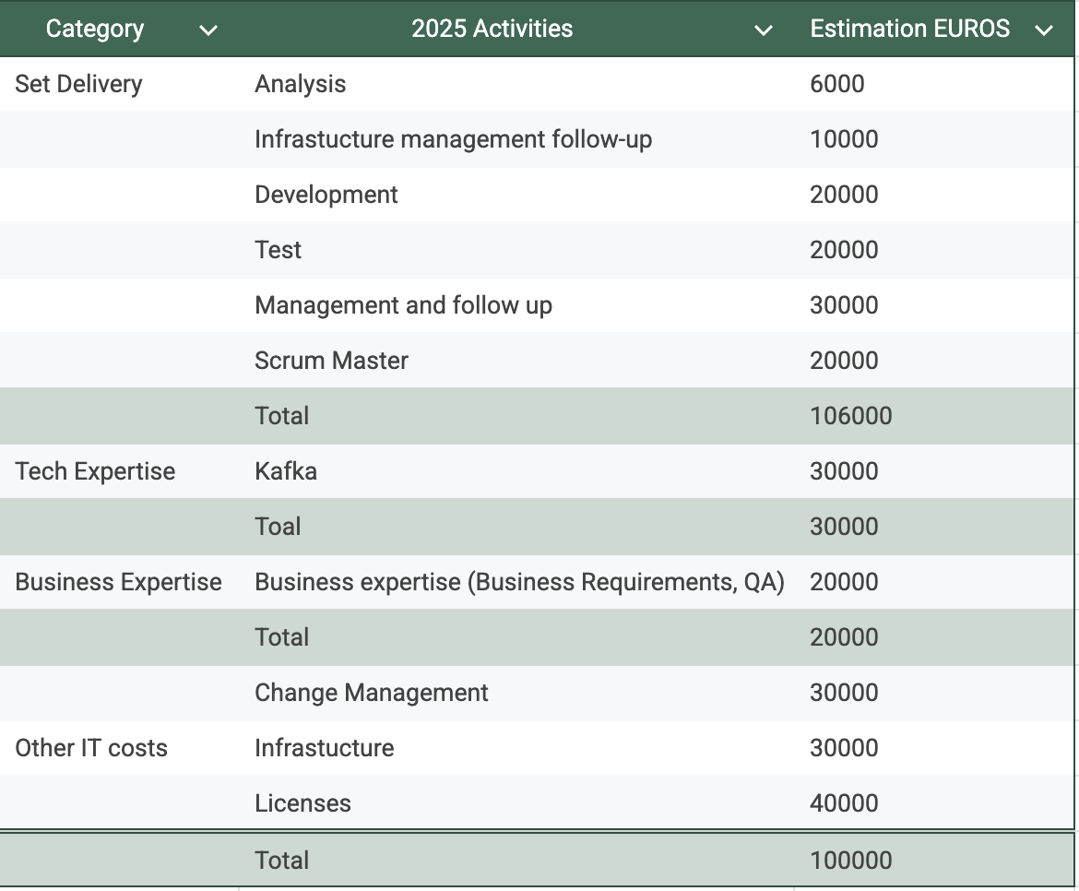
Financial

Slide 20
Annex

Slide 21
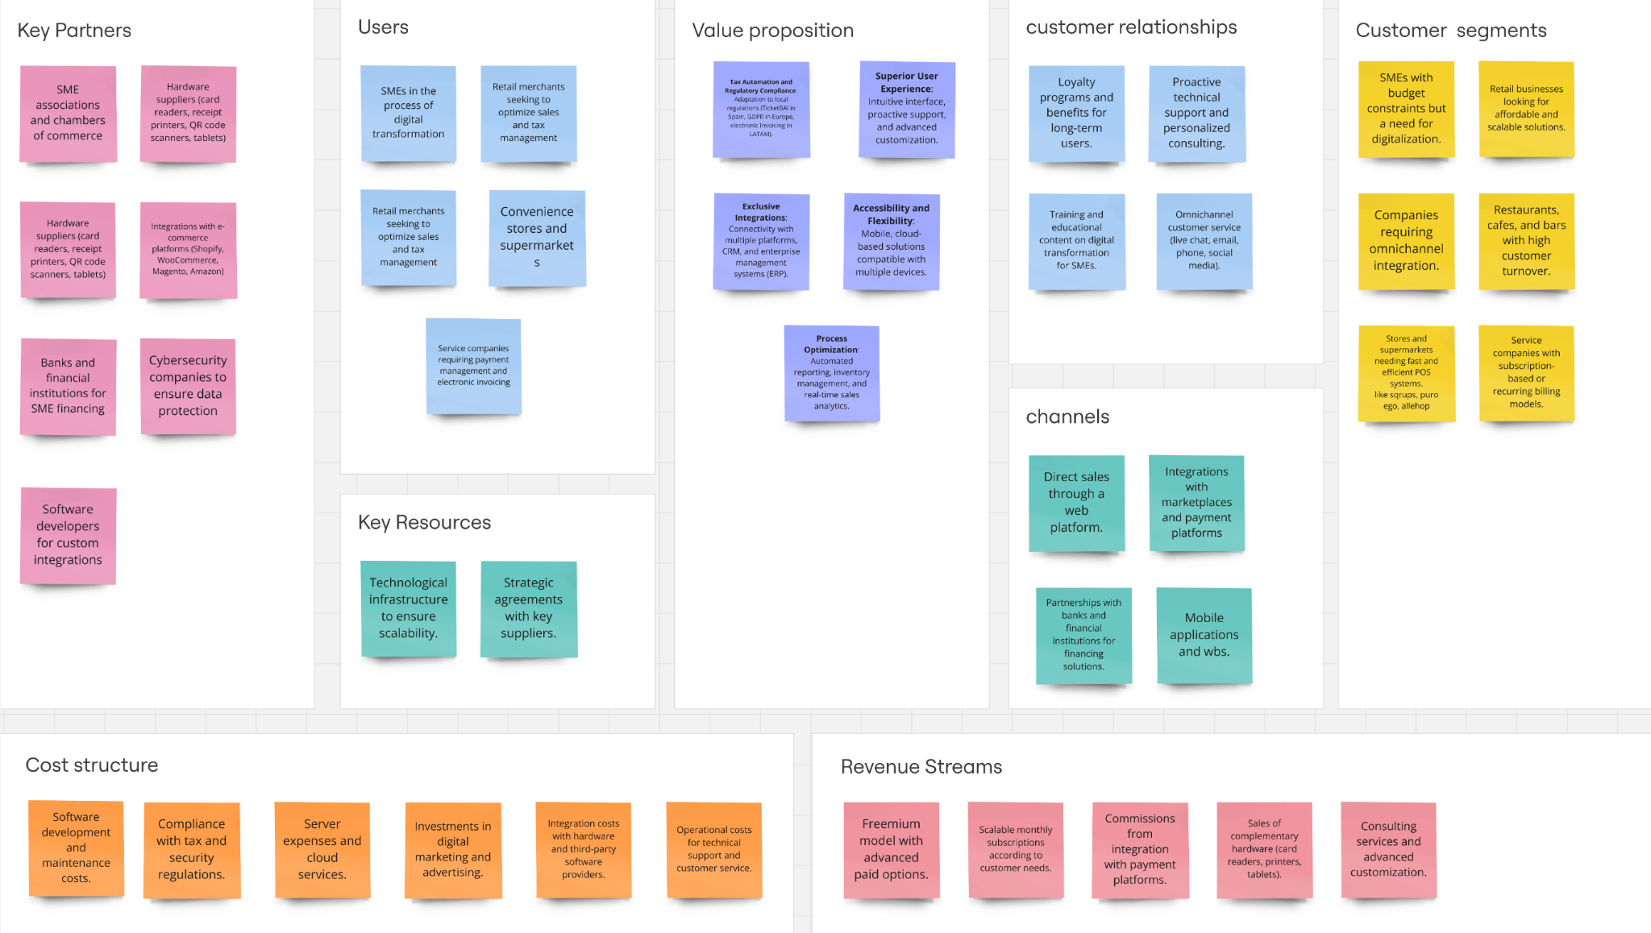

Slide 22
